Slide 1
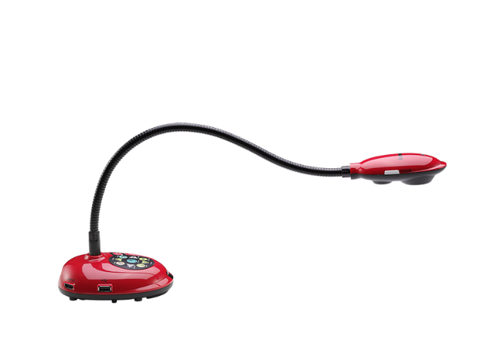
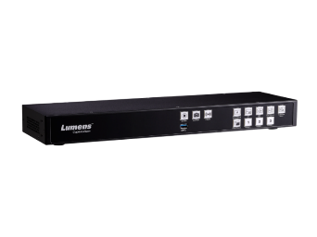
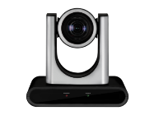
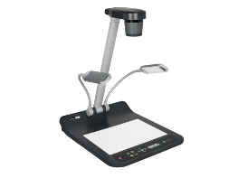
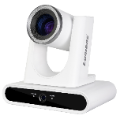
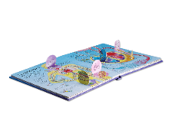
K-12 EDUCATION
SOLUTIONS
Innovative Technology for In-Person and Hybrid K-12 Learning

Slide 2
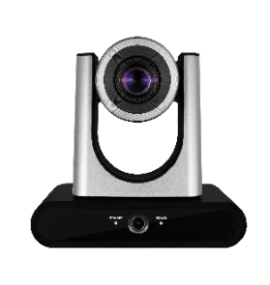
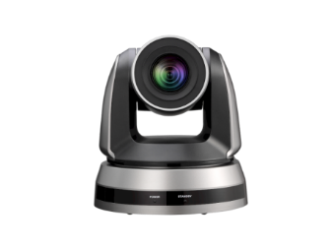
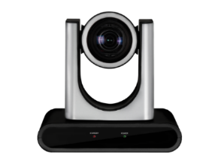
Hybrid Classroom
Products: PTZ Camera & Tracking Camera
For filming Video of the Teacher and Class Lesson
VC-TR40
VC-TA50
^{AI Auto Tracking Camera}
^{AI Auto Tracking PTZ Camera}
With dual lenses, suitable for classrooms with a horizontal wide range space.
Follow the instructor and have the best image quality.
Hybrid Classroom
VC-R30
VC-A51P
^{Full HD IP PTZ Camera}
^{Full HD PTZ Camera}
Scene: Hybrid Classroom
Application: Remote Learning
USB-out for easy connectivity, and suitable for a small to medium size classroom.
With 20x zoom, film the instructor up close.
Notes:
應用說明 hybrid classroom的用法：與學生共享與互動，引導學習 放大教材 立體物件
產品選擇：
https://graphicriver.net/item/foodiza-food-restaurant-powerpoint-presentation-template/32947958

Slide 3
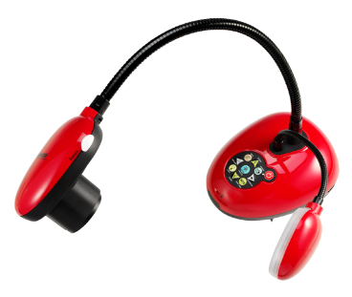
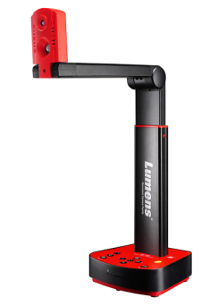
Hybrid Classroom
Products: Portable Visualizer & Document Camera
For Presenting Instructional Material Effectively
DC193
DC172
^{20x Zoom Document Camera}
^{4K HDMI Document Camera}
With the flexible gooseneck design, the camera can capture the image in multi-angles with a close-up view.
Annotate images and control menu settings by plugging simply a mouse into the camera.
DC-F80
PS753
^{4K Document Camera}
Scene: Hybrid Classroom
Application: Enhance visibility of the teaching material
^{4K Desktop Document Camera}
Large A3 viewing area and 3-level LED lighting elevate the presenting experience.
300x zoom lens and dual lights on adjustable gooseneck mounts capture the finest detail.
Notes:
應用說明 hybrid classroom的用法：與學生共享與互動，引導學習 放大教材 立體物件
產品選擇：

Slide 4
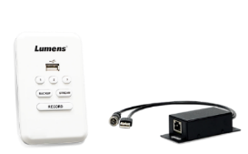
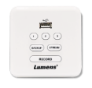
Hybrid Classroom
Products: Media Processor & Remote Control Panel
For Recording and Live-streaming Lectures
Hybrid Classroom
The Media Processor is mainly used to record the teaching process and live stream courses. With two video inputs, you can play video images of the course and the teacher’s digital content at the same time.
LC100
^{Media Processor}
2-Channel AV Source processing supports recording and live streaming function with FHD quality image.
LC-RC01
^{Remote Control Panel for LC100}
Used to operate the LC100 system and simply place on the desktop or hang on the classroom wall.
Scene: Hybrid Classroom
Application: Record and Live-stream Lectures
Notes:
應用說明 hybrid classroom的用法：與學生共享與互動，引導學習 放大教材 立體物件
產品選擇：

Slide 5
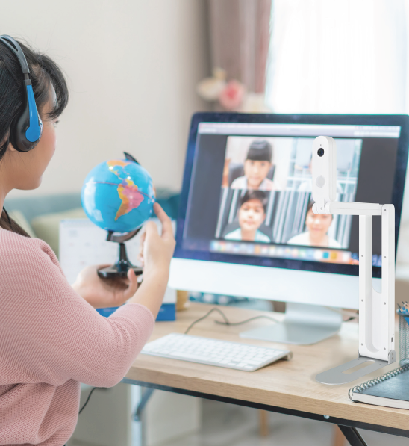
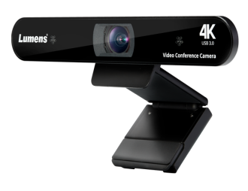
Distance Learning
Products: Document Camera & Video Conference Camera
For Filming Video of the Teacher and Teaching Material
VC-B2U
^{Full HD 90° FOV Webcam}
USB plug-and-play connectivity and tripod-ready universal clips for easy placement.
Distance Learning
DC-F20
^{HD/2K USB Document Camera}
One camera can be used in 2 ways, a document camera or a webcam.
VC-B11U
^{4K USB Conference Camera}
Scene: Teachers’ Home
Application: Remote Learning
Auto framing function increases the flexibility for gestures and movement while teaching.
Notes:
應用說明 hybrid classroom的用法：與學生共享與互動，引導學習 放大教材 立體物件
產品選擇：
https://graphicriver.net/item/foodiza-food-restaurant-powerpoint-presentation-template/32947958

Slide 6
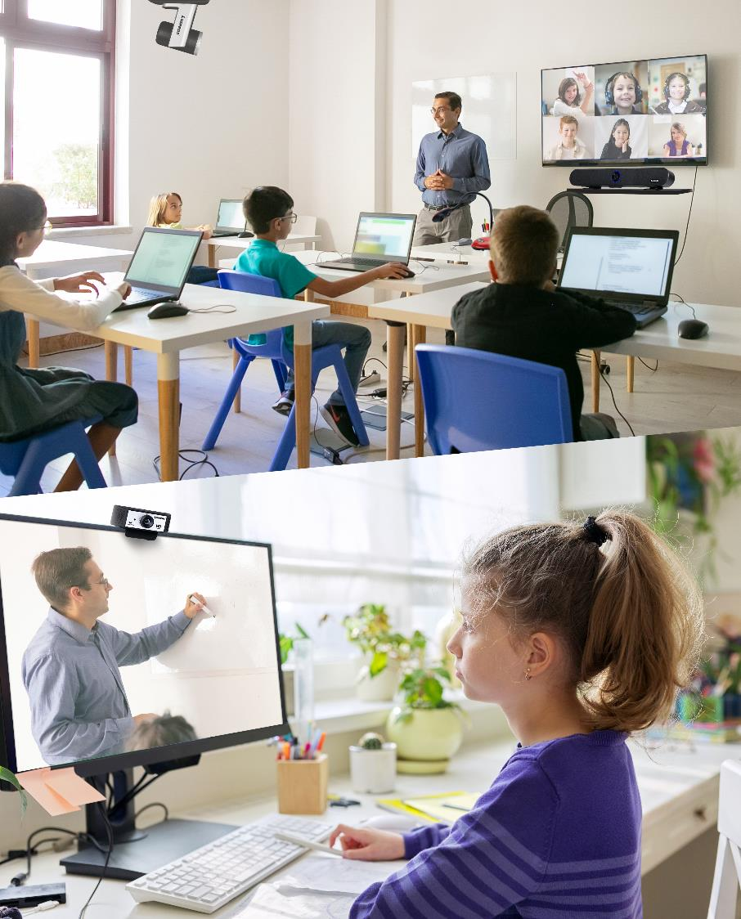
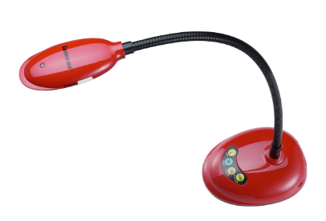
Distance Learning
Products: PTZ Camera & Video Conference Camera & Document Camera
For Filming Video of the Teacher and Instructional Material
Distance Learning
MS-10
DC136
^{4K Video Soundbar}
4K USB Document Camera
4K image quality, echo cancellation and noise suppression help to deliver clear teaching content.
With the flexible gooseneck design that can capture the image in multi-angles with a close-up.
VC-R30
VC-B30U
^{Full HD IP Camera}
Full HD USB PTZ Camera
Scene: Students’ Home
Application: Remote Learning
USB-out for easy connectivity for a small to medium size classroom.
12x zoom and smooth PTZ functionality.
Notes:
應用說明 hybrid classroom的用法：與學生共享與互動，引導學習 放大教材 立體物件
產品選擇：

Slide 7
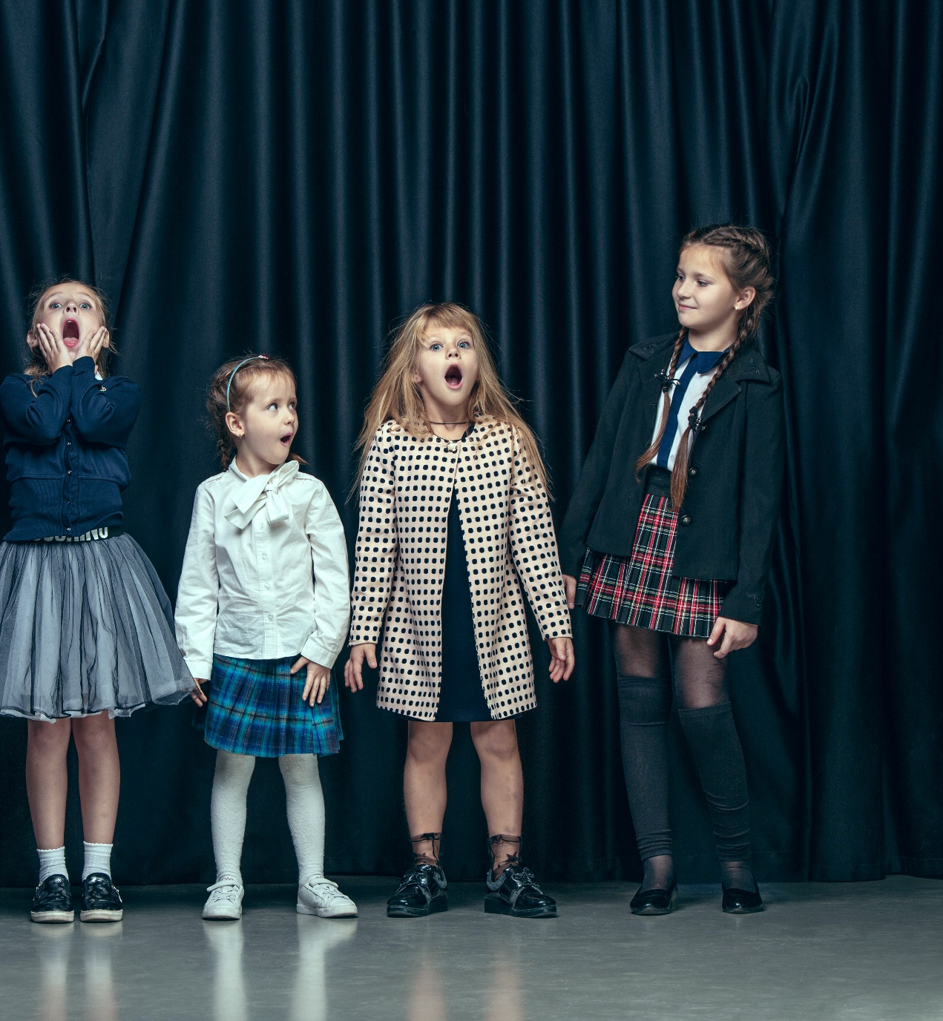
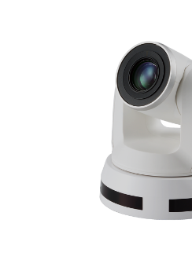
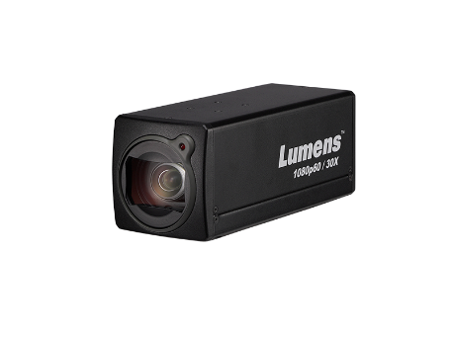
Auditorium
Products: PTZ Camera & Tracking Camera & Box Camera
For Effectively Tracking People and Filming a Live Events
VC-TR40
VC-TA50
^{AI Auto Tracking Camera}
^{AI Auto Tracking PTZ Camera}
Equipped with dual lenses for stage tracking and providing a close-up view.
Follow a person while keeping the face in sharp focus.
Auditorium
VC-A51P
VC-BC601P
^{Full HD PTZ Camera}
^{1080p IP Box Camera}
Scene: Auditorium
Application: Record and Live-stream Events
With 20x zoom, an event can be viewed up close for seeing details.
POV filming for different events and activities.
Notes:
圖片來源:https://www.freepik.com/free-photo/cute-stylish-children-dark-studio-beautiful-teen-girls-boy-standing-together_10961387.htm#query=Cute%20stylish%20children%20on%20dark%20beautiful%20teen%20girls%20and%20boy%20standing%20together&position=0&from_view=search&track=sph

Slide 8
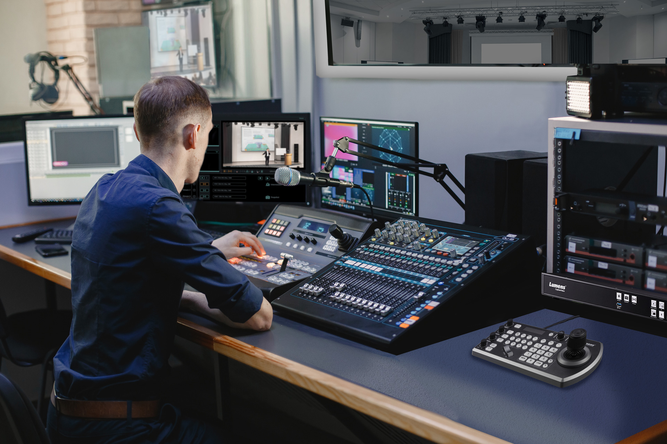
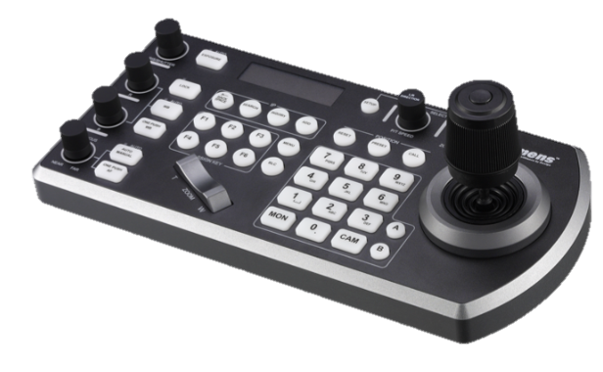
Auditorium
Products: Media Processor & Camera Controller
For Managing the Filming of the Events
Auditorium
The Media Processor is mainly used to record a lecture and offer live streaming. With 4 video inputs, you can play the live speech, present content, focus on the speaker and the attendees image at the same time.
LC200
^{Media Processor}
4-Input HD Video Switcher and Audio Mixer, which can display presentations, course videos and live speech at the same time.
VS-KB30
IP PTZ Camera Controller
The IP PTZ camera joystick for remote camera control enables to tilt, turn, and take a close-up view with the cameras.
Scene: Central control room
Application: Record and Live-stream Events

Slide 9
Thank you!

