Slide 1
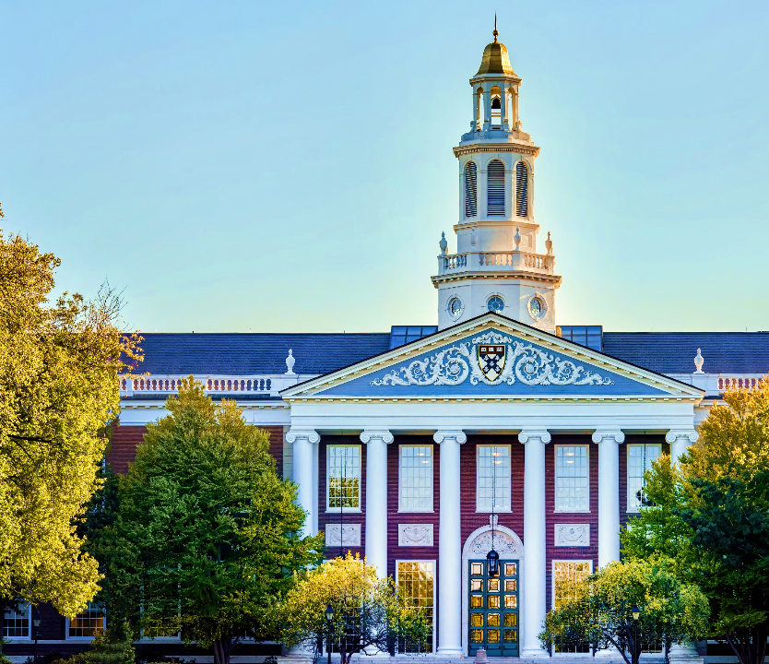
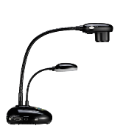
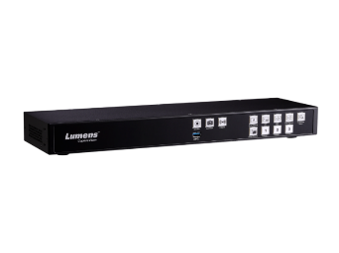
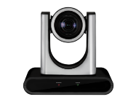
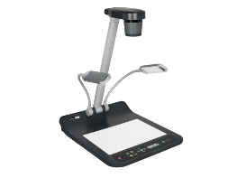
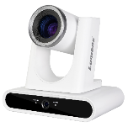
HIGHER EDUCATION
SOLUTIONS
The New Teaching Trend of Higher Education

Slide 2
CROSS CAMPUS BROADCASTING
Many colleges and schools rely on campus TV to engage with students. They use digital signage is used to advertise events, news and emergency information, with the option to transmit different messages being displayed to different groups of monitors.
Notes:
應用說明 hybrid classroom的用法：與學生共享與互動，引導學習 放大教材 立體物件
產品選擇：
https://graphicriver.net/item/foodiza-food-restaurant-powerpoint-presentation-template/32947958

Slide 3
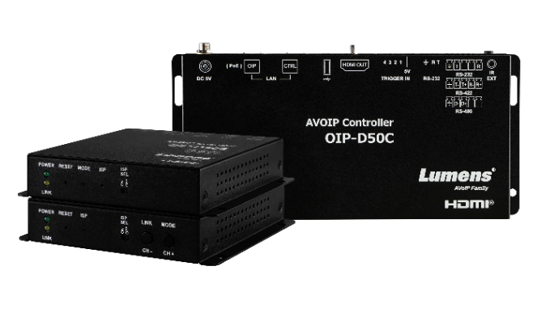
Cross Campus Broadcasting
THE FUTURE OF VIDEO NETWORKING AND DISTRIBUTION
Lumens AV OVER IP Solution
HD and 4K options available
Send multiple video sources to individual monitors, or groups of displays
Transmit HDMI signals over IP networks at very low latency
Supports video walls in portrait and landscape orientation
Video over IP systems need to meet three basic requirements:
• Secure, very low delay transmission over existing IP networks
• Manage the routing of each source to any monitor or monitors
• Support high quality HD or 4K HDMI video sources

Slide 4
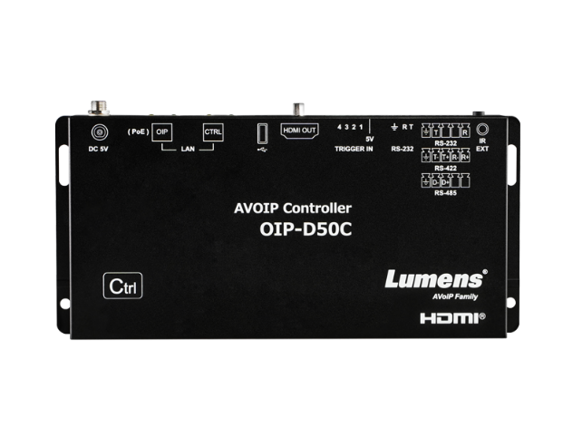
Cross Campus Broadcasting
**Note:
The warranty policy, TAA and NDAA compliant may be different depending on the sales region. Changes in specification or design may be done without notification.
Lumens VOIP System
High quality IP Transmission
number of encoders and decoders, transmitting data over 1Gb or 10Gb infrastructure. The solution is fully scalable – as your needs grow, so can your AV network.
Lumens Equipment
OIP-D50E 4K HDMI to IP Encoder OIP-D50D 4K IP Decoder to HDMI IP-D50C Network Matrix Controller
OIP-D40E HD HDMI to IP Encoder OIP-D40D HD IP Decoder to HDMI IP-D50C Network Matrix Controller
More Info.
Notes:
應用說明 hybrid classroom的用法：與學生共享與互動，引導學習 放大教材 立體物件
產品選擇：
https://graphicriver.net/item/foodiza-food-restaurant-powerpoint-presentation-template/32947958

Slide 5
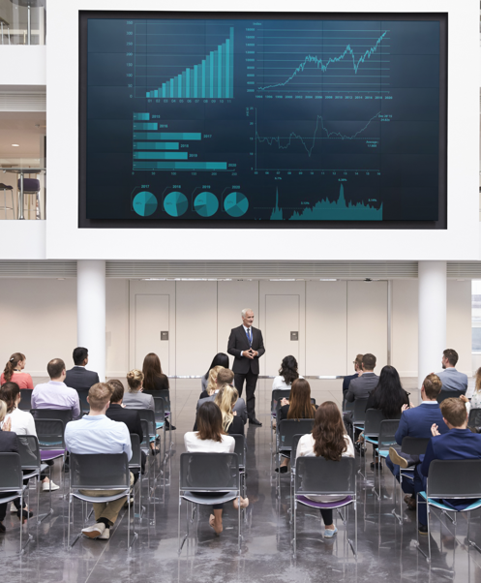
VIDEO WALLS
Large-scale LED displays are increasingly popular in colleges and universities. Making an instant impact and providing fantastic visual communication, video walls are found in sports venues, reception spaces, lecture halls and communal spaces.
Video wall controllers need to meet three basic requirements:
• Supports a variety of screen layouts, such as 8x2 or 4x4
• Display a single source over a large canvas or multiple sources to various windows
• Simple to transmit video and control the system over the local network
Notes:
應用說明 hybrid classroom的用法：與學生共享與互動，引導學習 放大教材 立體物件
產品選擇：
https://graphicriver.net/item/foodiza-food-restaurant-powerpoint-presentation-template/32947958

Slide 6
Video Walls
Lumens VOIP System
High quality video onto your video wall
Lumens OIP supports video output to multiple screens in either portrait or landscape orientation. By combining multiple HD screens, organizations can design stunning 2K, 4K and 8K video walls. Visually stunning and cost-effective, this is an ideal solution that can be used for student information, visitor communications and even security monitoring.
The concept is simple: the video source (such as a media player or live camera) is converted from HDMI and transmitted over IP to an HDMI decoder. By creating a matrix of encoders and decoders, any source can be displayed on any monitor, and a single source can be shown across multiple screens or on many individual displays.
Lumens Equipment
OIP-D50E 4K HDMI to IP Encoder OIP-D50D 4K IP Decoder to HDMI OIP-D50C Network Matrix Controller
Notes:
應用說明 hybrid classroom的用法：與學生共享與互動，引導學習 放大教材 立體物件
產品選擇：
https://graphicriver.net/item/foodiza-food-restaurant-powerpoint-presentation-template/32947958

Slide 7
HYBRID TEACHING
The hybrid classroom uses video conferencing platforms to enable students working from home to engage fully with teaching sessions. Lumens cameras deliver excellent quality results, enabling the teacher to use all the features of the technology with minimal training.
Notes:
應用說明 hybrid classroom的用法：與學生共享與互動，引導學習 放大教材 立體物件
產品選擇：
https://graphicriver.net/item/foodiza-food-restaurant-powerpoint-presentation-template/32947958

Slide 8
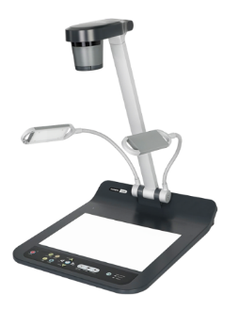
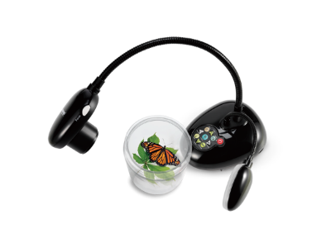
Hybrid Teaching
Desktop
Document Camera
With a backlit LED light under the display area, it’s ready to illuminate photo negatives from below.
DESKTOP VISUALIZER
Present and stream documents, objects and learning materials
Bring lessons to life by presenting pages of books, 3D objects, maps and other physical teaching materials on digital the smartboard. At the same time, connect the output to your VC platform (such as Teams or Zoom) to interact with learners who are connecting remotely to the lesson. Better still, the camera in the Lumens document camera can be positioned towards the teacher or students to face-to-face video conferencing with students at home.
Portable Document Camera
With flexible gooseneck design that can capture the image in multi-angles with a close-up.
Notes:
應用說明 hybrid classroom的用法：與學生共享與互動，引導學習 放大教材 立體物件
產品選擇：
https://graphicriver.net/item/foodiza-food-restaurant-powerpoint-presentation-template/32947958

Slide 9
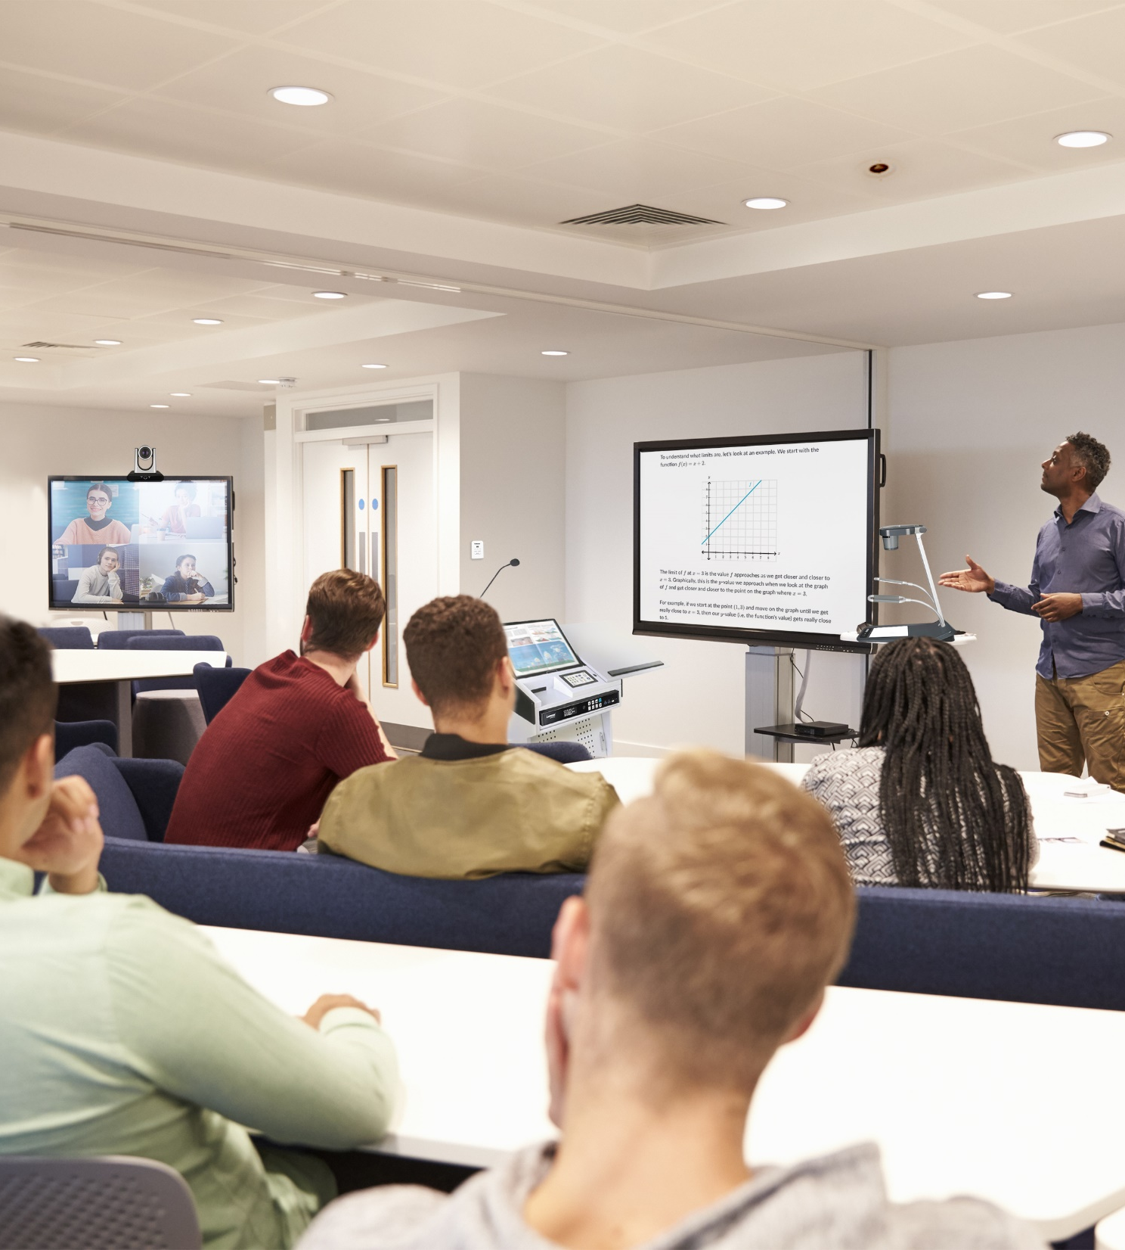
THE FLIPPED CLASSROOM
The flipped classroom makes learning resources available to students online that they can watch from home or their accommodation. Our auto-tracking cameras are designed to run automatically, delivering television style production values while dynamically following the teacher as they present to students. These cameras, as well as the output of laptops and document cameras can be captured by our CaptureVision Station which creates great looking videos ready to be streamed to your students.
Notes:
應用說明 hybrid classroom的用法：與學生共享與互動，引導學習 放大教材 立體物件
產品選擇：
https://graphicriver.net/item/foodiza-food-restaurant-powerpoint-presentation-template/32947958

Slide 10
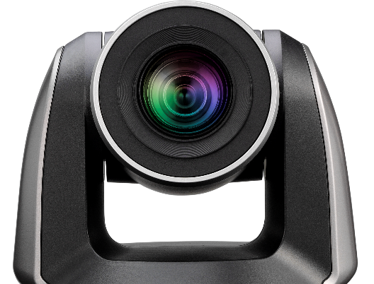
The Flipped Classroom
Auto-Tracking PTZ Camera
Create teaching resources with TV-style results
The auto-tracking camera automatically tracks teachers as they walk back and forth across a stage and classroom. You now don’t need a camera operator to create fantastic results.
LC100
Media Processor
CaptureVision Station LC100
4-channel HD switcher, recorder and live streaming media processor
Produce, record and stream professional video resources
Mix and switch two video sources
Simultaneous recording and streaming
Built-in 2TB HDD storage
Share with students online
Kaltura and Panopto-certified

Slide 11
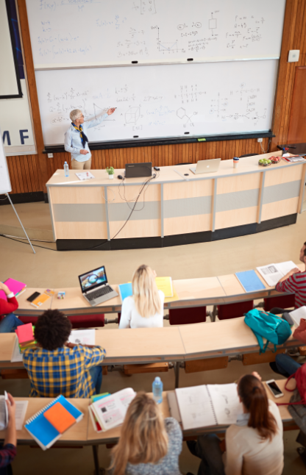
CAPTURING VIDEO IN LECTURE HALLS
It is now standard practice to record and stream lectures that take place in conference facilities and lecture halls. A professionally produced video will be a fantastic resource for students and show your faculty in its best light. To achieve this, we recommend using multiple camera angles and recording presentations directly from the lecturer’s laptop.
Notes:
應用說明 hybrid classroom的用法：與學生共享與互動，引導學習 放大教材 立體物件
產品選擇：
https://graphicriver.net/item/foodiza-food-restaurant-powerpoint-presentation-template/32947958

Slide 12
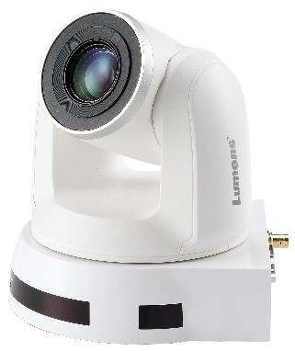
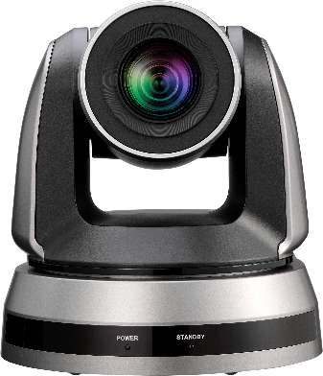
Capturing Video in Lecture Halls
Media Processor
CaptureVision Station LC200
4-channel HD switcher, recorder and live streaming media processor
Record 3 camera sources and the output from the lecturer’s laptop
4-channel recording
Simultaneous live streaming
4-input video processor (with HDMI and IP)
Source scaling switching and vision mixing
Panopto and Kaltura-certified
LC200
PTZ Camera
Effectively Track & Capture Presenter Content
Zoom, swivel and tilt, and move smoothly with remotely controlled PTZ cameras.
CL511
Ceiling Camera
Present Documents and 3D Objects
Provide an overhead view of a demonstration area with high-resolution image.
PTZ

Slide 13
Thank you!

